Slide 1
Synchronization

Slide 2
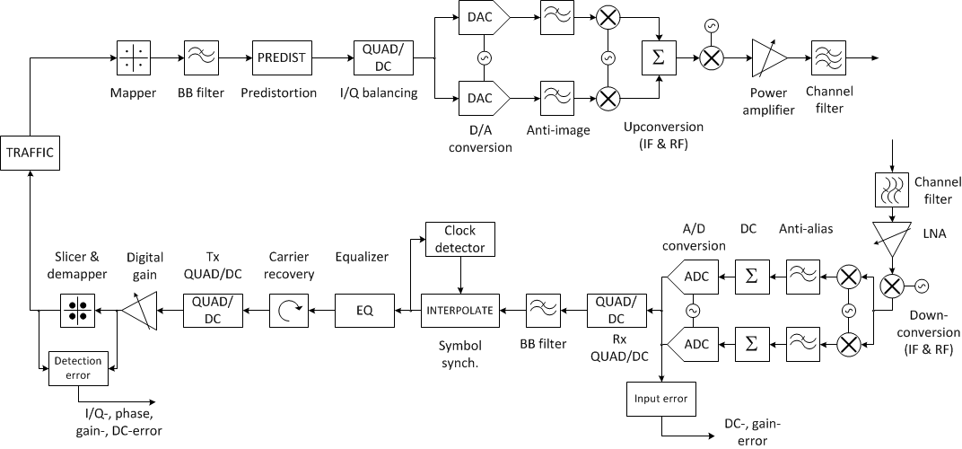

Slide 3
The mathematical foundation
Pulse shape
The transmitted signal
Communication symbols
Example

Slide 4
The mathematical foundation
Pulse shape
Unknown frequency and phase offset
Unknown time offset
Unknown amplitude
Communication symbols
AWGN
The received signal
Nuisance parameters
Parameters that we do not care about
Parameters to find
Parameters that we care about
The MAP detector
The pdf with impairments

Slide 5
The mathematical foundation
A common procedure is to make a good estimate of the synchronization parameters based on the received signal, and then assume that the estimated parameters are the true ones.
No uncertainty assumed
The pdf now becomes
The integral goes away
Compensation of the synchronization parameters now leeds to the simple received signal
This compensated received signal is without imparments and can be handled as usual.

Slide 6
The LMS algorithm
The Least Mean Squares (LMS) algorithm is a simple and useful algorithm to adaptively find and track parameter values in various systems. The algorithm consists of making small steps in the direction of the negative error gradient.
Example: We want to find the FIR filter that makes the filter output as close (MMSE) to a desired signal as possible. The filtering operation is defined as
with an error given by , where is the desired filter output. Trying to minimize the instantaneous quadratic error, we compute the gradient as
The resulting algorithm is thus
There are many modified versions of the LMS algorithm. For example, it is possible to make the step size constant,
In some applications it is an advantage to make the step size adaptive.

Slide 7
Automatic Gain Control
The gain is typically adjusted to give a constant average power output.
For each sample, compute the power (the square of the amplitude, ) and lowpass filter this random sequence. The gain should be adjusted to make the average power e.g. 1.
MATLAB code
P = (1-mu)*P + mu*abs(x)^2;
y = sqrt(1/P)*x;
The variable mu should be in the order 0.01, but it depends a lot on the application.

Slide 8
Symbol timing synchronization Eye diagrams
The eye diagram is a plot of the signal at the output of the matched filter, before it is sampled at symbol rate. In the diagram to the right, the ideal sampling times are the integer seconds (0, 1, 2, 3, 4).
A time error will lead to a smaller distance between the different possible symbols.

Slide 9
Symbol timing synchronization Gardner Timing Recovery
An error signal is computed as
This error signal is negative when the sampling moment is too early (or vice versa). Thus, it can be used to move the sampling instant in the correct direction. At least two samples per symbol interval is needed to use this method.
Illustration of 16-QAM

Slide 10
Phase synchronization
Use only corners!
if (abs(x)>threshold
ang = angle(x)+a;
ang_correct = floor(ang*2/pi)*pi/2+pi/4;
e = ang_correct-ang;
a = a+mu*e;
end
y = x*exp(1i*a);
This algorithm can only correct the phase up to 90 degrees accuracy. The algorithm cannot compensate for which of the four corners that it has found, so it has a ambiguity with 4 possibilities. This can only be resolved with a known sequence (preamble).

Slide 11
Frequency synchronization
Only phase syncronization
if (abs(x)>threshold
ang=angle(x)+a+bsum;
ang_correct=floor(ang*2/pi)*pi/2+pi/4;
e=ang_correct-ang;
a=a+mu*e;
b=b+mu*0.01*e;
end
bsum=bsum+b;
y = x*exp(1i*(a+bsum));
Phase and frequency syncronization

Slide 12
Frame synchronization
The data is normally organized in a sequence of frames. Each frame must have a preamble so that the frame start can be recognized. The preamble could for example consist of a sequence of consecutive +1 and -1 symbols, or it could be a random sequence.
pre-amble
payload data
a frame
The preamble should be easy to decode, since you want to avoid bit errors here. At the same time, it must be long enough to make the probability small that a data sequence is mistaken for the preamble.

Slide 13
Frame synchronization
To find the exact moment of the frame start, we compute the cross-correlation between the received sequence and the pre-amble sequence.
(in MATLAB this is performed by ”r=xcorr(x,y);”. The magnitude of the cross-correlation will have a clearly visible peak at a time delay k that corresponds to the point where the received signal y is similar to the preamble x.
>> r=xcorr(x,y);
>> plot(abs(r))
>> [m,i]=max(abs(r));
Here, i is the position of the maximum.
Note that the xcorr function introduces a delay of half the blocklength. Make some experiments using known preamble positions to understand how to do this.

Slide 14
Equalization
The equalizer typically consists of a linear FIR filter whose task is to invert the channel, either by making the channel-equalizer combination filter as close to an impulse as possible, or by finding the least-square equalizer, that makes the quadratic error minimal.
If we can assume the desired output from the equalizer filter to be known (as in the preamble), the LMS algorithm is a good choice.
There are also many blind algorithms (when the desired output is unknown) to choose from. One is the Bussgang method, where the equalizer weights are updated as
(a and b must be numerically found)
Channel
Equalizer

Slide 15
Digital predistortion
A digital predistorter (DPD) is a device that tries to pre-compensate the nonlinear behaviour of the transmitter (typically dominated by the power amplifier).
A common model for the DPD is to use a complex polynomial of the form
The coefficients must be identified, which is not a trivial task. Suggestion: compute the optimal post-distorter, and use the resulting function as a predistorter.
Amplifier
DPD

Slide 16
Digital predistortion
Amplifier
DPD
postD
Rescale to the desired power
Compute the optimal post-distorter
Use as a predistorter
MATLAB
H=[y y.*abs(y)^2 ...];
theta=pinv(H)*x;
Hu=[u u.*abs(u)^2 ...];
x=Hu*theta;

Slide 17
Decision feedback
After some time, the blind synchronization algorithms stabilizes and produce a useful output. To improve the performance from this point, decision feedback can be used, where preliminary decisions are made, and are used to improve the tracking performance of the algorithms.
Since the algorithms are not blind any longer, the performance is better.
Example: Since we have a preliminary decision of the transmitted symbol, the phase and frequency tracking algorithm can be improved by incorporating this knowledge in the update equations. We can use all symbols for updates, not only the corners.
ang=angle(x)+a+bsum;
ang_correct=angle(x_decision);
e=ang_correct-ang;
a=a+mu*e;
b=b+mu*0.1*e;
bsum=bsum+b;
y = x*exp(1i*(a+bsum));

Slide 18
Block-based algorithms
With block-based algorithms, data for a full frame is collected, and parameters are estimated based on the entire block. This is in contrast to sample adaptive techniques (e.g. LMS, Garder etc) that we studied earlier.
Example: Gain compensation
Estimate the power
Compensate the gain

